Slide 1


Book Sales Data Analysis
By:Virendra raikwar
https://github.com/VirendraR2107/Book-Sales-Analysis
https://www.linkedin.com/in/virendra-raikwar-3858992b4/

Slide 2
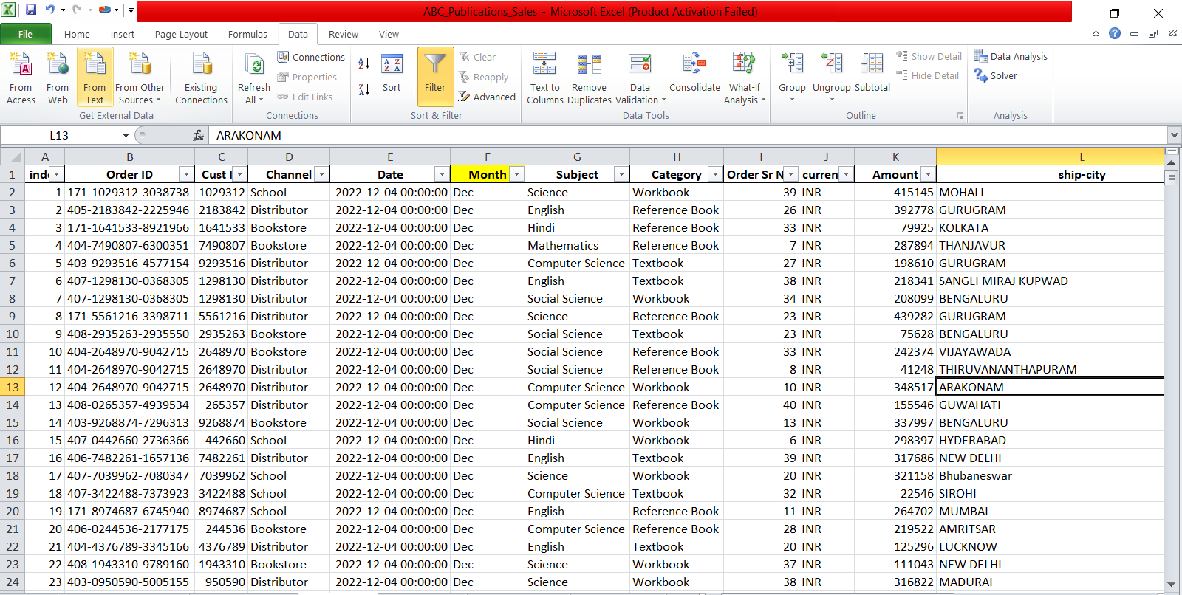
This is a school book sales dataset from ABC Publisher. It contains 18 columns and more than 30,000 data points. As a publication, it is very important to understand all key aspects of their business.

Slide 3
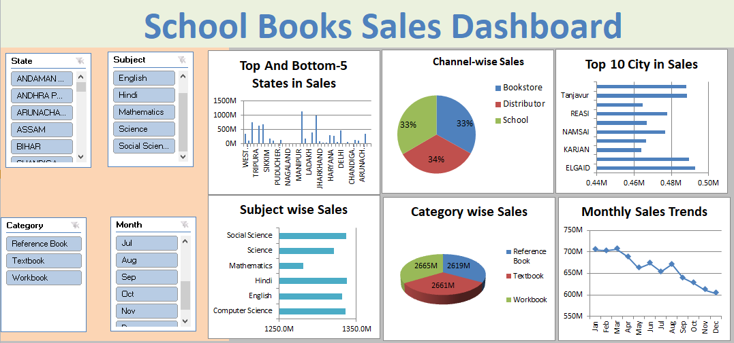
This dashboard is a part of school book sales and includes charts that highlight important insights from the data. This is just a brief analysis; we can conduct a deeper analysis as well.

Slide 4
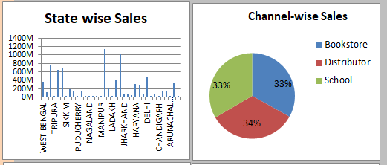
The charts below show which state in India has the highest and lowest sales in a year, as well as which sales channel has the maximum or minimum sales. We can also filter the data by the top 5 or bottom 5 for better clarity

Slide 5
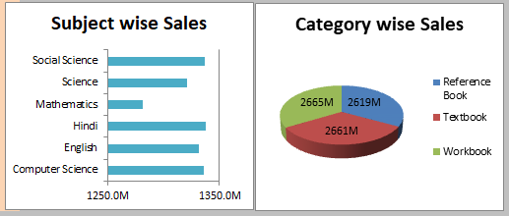
The horizontal bar chart shows subject-wise sales, while the pie chart represents category-wise sales

Slide 6
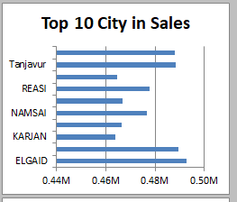
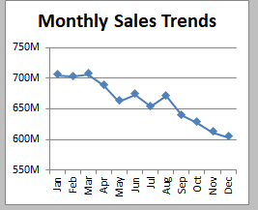
Here are the top cities in sales, and the line chart shows monthly sales trends. The sales period is from January to August, as this timeframe aligns with the preparation for the new school session.

Slide 7
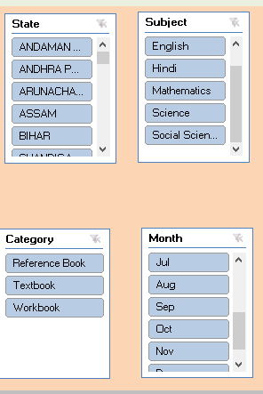
we use these slicers to manage all my Pivot Charts, connecting them for an interactive dashboard.

Slide 8
Note
This is a synthetic dataset created using Excel functions and ChatGPT. Therefore, I am not sharing any insights. The purpose of this project is to showcase my skills in performing real-world data analysis using Excel and Power BI. It demonstrates how to use Pivot Tables and Pivot Charts to make analysis impactful.

Slide 9


